Slide 1

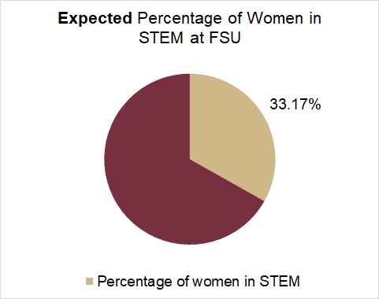
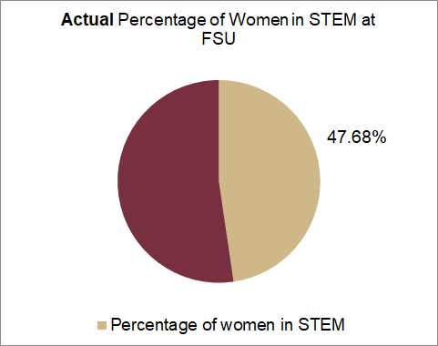
FSU’s complicated relationship with STEM and Gender:
The impact of a gendered divide in FSU’s STEM classrooms
Introduction
The concept of a gap existing between the technology haves and the technology have-nots is commonly referred to as the digital divide. When considering the digital divide, it is common to cluster populations based on different classifiers. For the purposes of this study, the gendered digital divide will be analyzed. That is, this study aims to analyze the discrepancies between male technological adopters and female technological adopters. We believe that the effects of the digital divide can be associated with stereotypes surrounding women and their interaction with technology, as well as academic policies and practices, which can in turn affect outcomes for employability and workplace relations for the digitally marginalized.
Method
We created a Qualtrics survey asking about undergraduate students at FSU about their experience with FSU’s STEM programs and their perception of the gender divide. Our recruitment strategy was using various social platforms such as GroupMe, Discord and Facebook. We also recruited survey participants through online lectures such as Zoom and Blackboard Collaborate. There were a total of 76 respondents. The data was used to compare the survey results to national data about women in STEM.
Results
Our quantitative analysis determined that both men and women perceive a digital divide in the STEM programs at FSU, with an average perception that 33% of the STEM population at FSU identify as women. Furthermore, our qualitative analysis determined that female STEM students at FSU often feel underrepresented by the demographics of their classmates (57%), and that the majority of female STEM students feel that they are given equal access to the resources needed for them to succeed (70%).
Discussion
After gathering results, we utilized Excel to group our data by questions and responses. In this way, we could perform analysis through visual annotations as well as through statistical models. Additionally, Excel also served as a tool to visualize our data in a variety of graphs and charts to make our results more readable. The results of our survey were then examined through a quantitative and qualitative fashion.
Conclusion
Our study concludes that work must be done to address the gap between the perceived digital divide and the reality of the digital divide. We determined that the estimated percentage of women in STEM at FSU was 47.7%; with the national average being 38.6%. Our group suggests that supplementary research must be done at other universities to better grasp the divide at large. As for FSU, we suggest that resources be allocated to increase the comfortability of female STEM students.
Sources:
Singh, I. (2020, November 27). By the numbers: Women in STEM: What do the statistics reveal about ongoing gender disparities? Yale Scientific.
Office of Institutional Research. (n.d.). Office of Institutional Research. FSU Enrollment at a Glance. Retrieved December 3, 2021, from https://ir.fsu.edu/enrollment.aspx.
Florida State University. (n.d.). FSU Eligible STEM majors. FSU Eligible STEM Majors. Retrieved December 3, 2021, from https://cge.fsu.edu/international-students/current-students/employment/practical-training-f-1/stem-opt/fsu-eligible-stem-majors.

